Slide 1
SAP FIORI

Slide 2
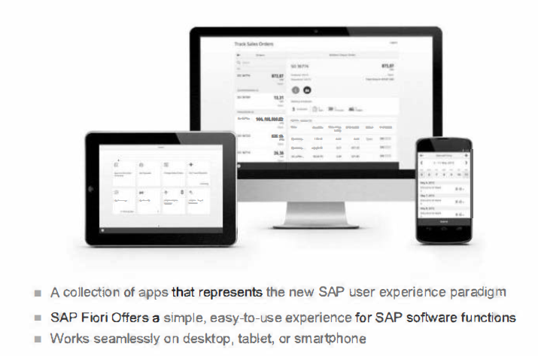

Slide 3
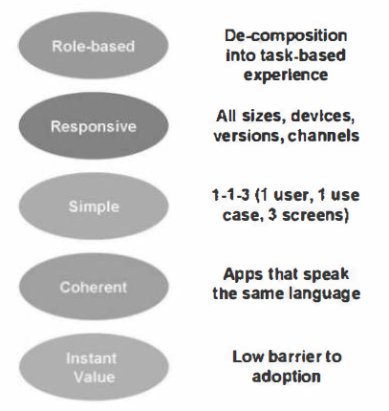

Slide 4
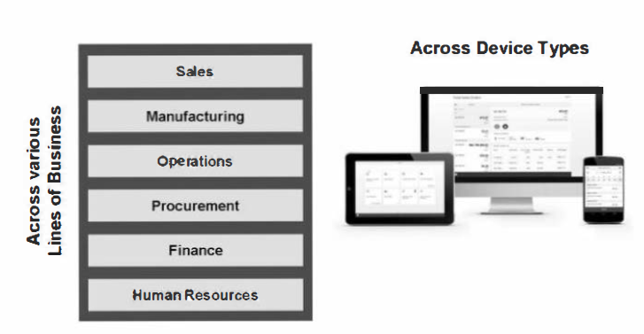

Slide 5
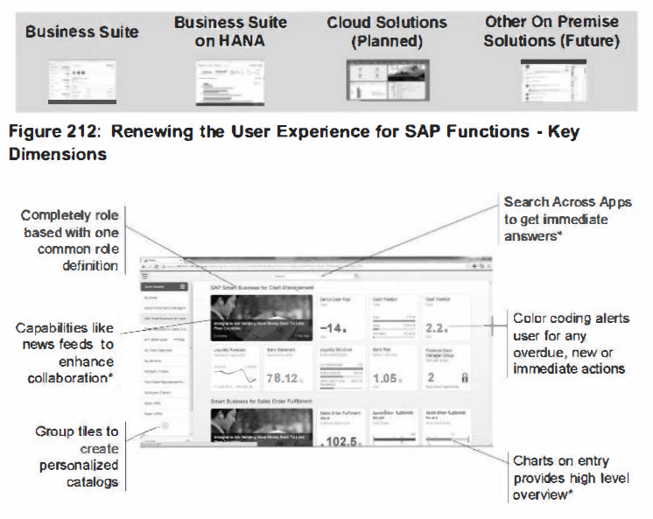

Slide 6
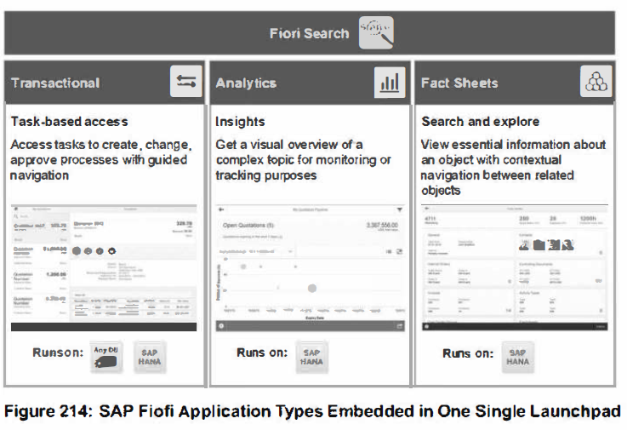

Slide 7
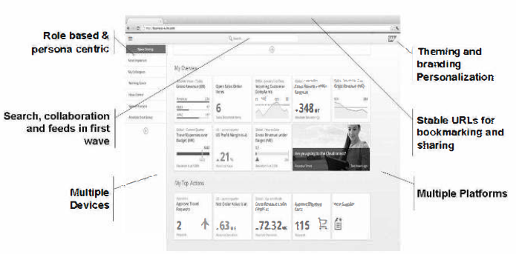
Fiori Launchpad - One entry point for the user

Slide 8
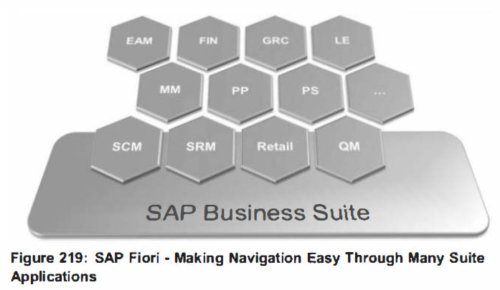
The users are not driven by complex transactions anymore. They are driven by their data and an agile User Interface.

Slide 9
Smart Business powered by SAP HANA
Smart Business powered by SAP HANA provides a new working model addressing the new management principles of being more close to the operation
Real-time visualization of key performance indicators including trends, thresholds and alerts
Real time analysis of variances & deviations on high volume data
Deep integration with collaboration tools for accelerated problem solving
Prediction capabilities based on current as well as on historical data
SAP Smart Business is an open framework. Customers and partners can define their own KPIs and integrate with collaboration & analytical tools (e.g. Lumira) or existing applications

